Slide 1
Course Contents
Introduction
Linked Lists
Stacks and Queues
Trees
Graphs
Searching and Sorting Techniques

Slide 2
What is Data Structure?
Data structure is the way to store and organize data in order to facilitate access and modification
OR
The logical or mathematical model of a particular organization of data is called data structure.
Notes:
Data structure : conceptual and concrete ways to organize data for efficient storage and manipulation

Slide 3
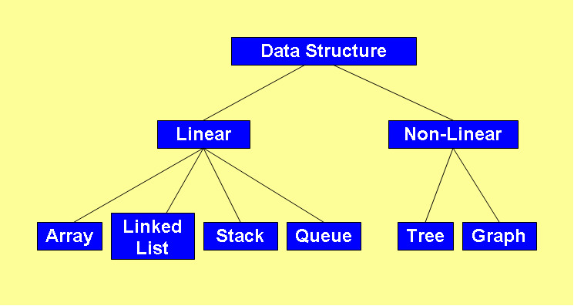
Classification of Data Structure

Slide 4
Programmer’s considerations
How to store data in computer’s memory?
Whether the method works for a hundred file cards? A thousand ? A million?
Whether the method permits quick insertion or deletion?
Whether it allows for fast searching?
Notes:
● How would you store the data in your computer’s memory?
● Would your method work for a hundred file cards? A thousand? A million?
● Would your method permit quick insertion of new cards and deletion of old ones?
● Would it allow for fast searching for a specified card?
● Suppose you wanted to arrange the cards in alphabetical order. How would you sort them?

Slide 5
Pointers
main( )
{
int i = 3;
int *j;
j=&i;
printf(“\nAddress of i = %u”, &i);
printf(“\nAddress of i = %u”, j);
printf(“\nAddress of j = %u”, &j);
printf(“\nValue of j = %d”, j);
printf(“\nValue of i = %d”, i);
printf(“\nValue of i = %d”, *(&i));
printf(“\nValue of i = %d”, *j);
}
Output:
Address of i = 6485
Address of i = 6485
Address of j = 3276
Value of j = 6485
Value of i = 3
Value of i = 3
Value of i = 3

Slide 6
Structures in C
A structure gathers together different atoms of information that form a given entity ➔ structure combines dissimilar data types into a single entity
E.g. Book is described as title, author, call number, publisher, number of pages, date of publication, price etc.

Slide 7
Structures - Example
main()
{
struct account
{
int no;
char name[15];
float balance;
};
struct account a1, a2, a3;
printf(“\nEnter account nos., names and balances\n”);
scanf(“%d %s %f”, &a1.no, a1.name, &a1.balance);
scanf(“%d %s %f”, &a2.no, a2.name, &a2.balance);
scanf(“%d %s %f”, &a3.no, a3.name, &a3.balance);
printf(“\n%d %s %f”, a1.no, a1.name, a1.balance);
printf(“\n%d %s %f”, a2.no, a2.name, a2.balance);
printf(“\n%d %s %f”, a3.no, a3.name, a3.balance);
}
a1.no a1.name a1.balance
4001 4003 4018
Structure Name
375 Sameer\0 1234.55
Structure Elements
Structure Variables

Slide 8
Array of Structures
main()
{
struct account
{
int no;
float balance;
};
struct account a[10];
int i, acn;
float bal;
for (i=0; i<=9; i++)
{
printf(“\nEnter account no. and balance: ”);
scanf(“%d %f”, &acn, &bal);
a[i].no = acn;
a[i].balance = bal;
printf(“\n%d %f”, a[i].no, a[i].balance);
}
}
a[0].no a[0].balance a[1].no a[1].balance a[9].no a[9].balance
4001 4003 4007 4009 4055 4057
375 1234.55 405 2446.60 ---- 209 6489.75

Slide 9
Designing Recursive Algorithms
Rules
First, determine the base case
Then determine the general case
Combine the base case and the general cases into an algorithm

Slide 10
Direct Vs Indirect Recursion
Direct recursion occurs when a function or method invokes itself
Indirect recursion occurs when a function or method invokes another function or method, eventually resulting in the original function or method being invoked again

Slide 11
Hanoi Strategy (Generalization)
General strategy for moving N disks from the source peg to the destination peg:
1. Move the topmost N − 1 disks from the source peg to
the extra peg [General Case] A → B
2. Move the largest disk from source peg to destination
peg [Base Case] A → C
3. Move N − 1 disks from the extra peg to the destination
peg [General Case] B → C
11
Notes:
The rules imply that smaller disks must be “out of the way” to move larger disks from one peg to another

Slide 12
Recursive Solution
12
This strategy lends itself to a recursive solution
Step 1 and 3 are the same problems over and over again: move a stack of disks
– the problem size is reduced each time;
– what’s referred to as the destination and extra peg may change each time
The base case for this problem occurs when we want to move a “stack” that consists of only one disk. This step can be accomplished without recursion.

Slide 13
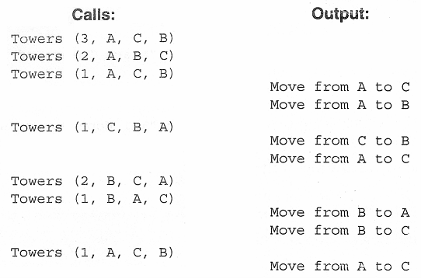
Towers of Hanoi – C Implementation
/* Test Towers of Hanoi */ /* Recursive approach */
#include<stdio.h>
void towers(int n, char source, char dest, char extra);
void main(void)
{
int numDisks;
printf("Please enter number of disks: ");
scanf("%d", &numDisks);
printf("\n\nStart Towers of Hanoi\n\n");
towers(numDisks, 'A', 'C', 'B');
printf("\n\nEnd");
}
void towers(int n, char source, char dest, char extra)
{
static int step = 0;
printf("Towers (%d %c %c %c)\n", n, source, dest, extra);
if (n==1) /* Base case */
printf("\t\t\t Step %3d: Move from %c to %c\n",++step, source, dest);
else /* General case */
{
towers (n-1, source, extra, dest);
printf("\t\t\t Step %3d: Move from %c to %c\n",++step, source, dest);
towers (n-1, extra, dest, source);
}
}
13

Slide 14
Array Problems
WCE - SY (CSE) – CS 212: Data Structures and Files
Subject Teacher: Smriti Bhandari

Slide 15
1. find-a-triplet-that-sum-to-a-given-value
15
Input: array = {12, 3, 4, 1, 6, 9}, sum = 24; Output: 12, 3, 9
Sort the given array.
Loop over the array and fix the first element of the possible triplet, arr[i].
Then fix two pointers, one at i + 1 and the other at n – 1. And look at the sum,
If the sum is smaller than the required sum, increment the first pointer.
Else, If the sum is bigger, Decrease the end pointer to reduce the sum.
Else, if the sum of elements at two-pointer is equal to given sum then print the triplet and break.

Slide 16
2. Find position of an element in a sorted array of infinite numbers
16
Since array is sorted, the first thing clicks into mind is binary search, but the problem here is that we don’t know size of array.
Let low be pointing to 1st element and high pointing to 2nd element of array, Now compare key with high index element, ->if it is greater than high index element then copy high index in low index and double the high index. ->if it is smaller, then apply binary search on high and low indices found
Find the only repetitive element between 1 to n-1
We know sum of first n-1 natural numbers is (n – 1)*n/2. We compute sum of array elements and subtract natural number sum from it to find the only missing element.

Slide 17
3. K’th Smallest/Largest Element in Unsorted Array
17
We can find k’th smallest element in time complexity better than O(N Log N). A simple optomization is to create a Min Heap of the given n elements and call extractMin() k times.
Time complexity of this solution is O(n + kLogn).
Mean of an array = (sum of all elements) / (number of elements)
Median of a sorted array of size n is defined as the middle element when n is odd and average of middle two elements when n is even. Since the array is not sorted here, we sort the array first, then apply above formula.

Slide 18
4. Find k numbers with most occurrences in the given array
18
Create a HashMap to store element-frequency pair in the HashMap. HashMap is used to perform insertion and updation in constant time. Then use a priority queue to store the element-frequency pair (Max-Heap). This gives the element which has maximum frequency at the root of the Priority Queue. Remove the top or root of Priority Queue K times and print the element

Slide 19
Linked Lists
[Module – 2]
WCE - SY (CSE) – CS 212: Data Structures and Files
Subject Teacher: Smriti Bhandari

Slide 20
What to Study?
Concept of linked organization
Singly linked list
Doubly linked list
Circular linked list
Operations
Insertion, deletion, inversion, concatenation, Computation of length, traversal on linked list
Representation & manipulations of polynomials using linked lists
20

Slide 21
Ways to store the data
Arrays
Linked Lists

Slide 22
Linked Lists
Linear collection of data elements called nodes, where the linear order is given by means of pointers
Each node is divided into two parts:
Part 1 : contains information / data
Part 2 : called link field, contains address of the next node in the list

Slide 23
Implementation of Linked Lists
Static Implementation
Using Parallel arrays
Using Array of Structures
Dynamic Implementation

Slide 24
Static Implementation Using Parallel Arrays
Easiest way of implementation
Start=9 ➔ info[9]=‘S’ (first node)
Successor[9]=6 ➔ info[6]=‘O’ (second node)
Successor[6]=5 ➔ info[5]=‘N’ (third node)
Successor[5]=2 ➔ info[2]=‘G’ (fourth node)
Successor[2]=-1 ➔ illegal index value ➔ end of list
Index | Info |  | Successor
0
1
2 | G |  | -1
3
4
5 | N |  | 2
6 | O |  | 5
7
8
9 | S |  | 6
Start

Slide 25
Static Implementation Using Array of Structures
# define MAXNODES 100
struct nodetype
{
int info; /* Information field of node */
int next; /* Pointer to its successor */
}
struct nodetype node[maxnodes];
[Note: next node is represented by an array index]

Slide 26
Linked List
A linear data structure to store data elements
Each node contains two parts:
Part 1: contains information / data
Part 2: contains the address of the next node
(pointer / link)
Elements that are logically adjacent need not be physically adjacent in the memory

Slide 27
Linked List
Basic Operations
Insertion / addition
Deletion
Retrieval
Traversal
Reverse

Slide 28
Algorithm – Insert List Node
Algorithm insertNode (start, pPre, dataIn)
Insert data into a new node in the list
pPre is pointer to data’s logical predecessor
dataIn contains data to be inserted
allocate (pNew)
set pNew data to dataIn
if (pPre NULL)
Adding before first node or to empty list
set pNew link to start
set start to pNew
else
Adding in middle or at end
set pNew link to pPre link
set pPre link to pNew
end if
return true
end insertNode

Slide 29
Algorithm – Delete List Node
Algorithm deleteNode (start, pPre, pLoc, dataOut)
Deletes data from list and returns it to calling module
pPre is a pointer to predecessor node
pLoc is a pointer to node to be deleted
dataOut is variable to receive deleted data
move pLoc data to dataOut
if (pPre NULL)
Deleting first node
set start to pLoc link
else
Deleting other nodes
set pPre link to pLoc link
end if
recycle (pLoc)
end deleteNode

Slide 30
Algorithm – Search Ordered List
Algorithm searchList (start, pPre, pLoc, target)
Searches list and passes back address of node containing target and its logical predecessor
pPre is a pointer to predecessor node
pLoc is a pointer to current node
target is the key being sought
set pPre to null
set pLoc to start
loop (pLoc not null AND target > pLoc key)
set pPre to pLoc
set pLoc to pLoc link
end loop
if (pLoc null)
Set return value
set found to false
else
if (target equal pLoc key)
set found to true
else
set found to false
end if
end if
return found
end searchList

Slide 31
Linked List ADT Implementation
Generic
typedef struct node
{
void* dataPtr;
struct node* link;
} NODE;
E.g. Integer
typedef struct node
{
int data;
struct node* link;
}NODE;
OR
struct node
{
int data;
struct node* link;
};

Slide 32
Doubly Linked List
Two-way list : One can move in either directions from L to R or from R to L
Each node has three parts:
info field : contains data
next pointer field : contains location of the next node (forward pointer)
prev pointer field : contains location of the preceding node (backward pointer)

Slide 33
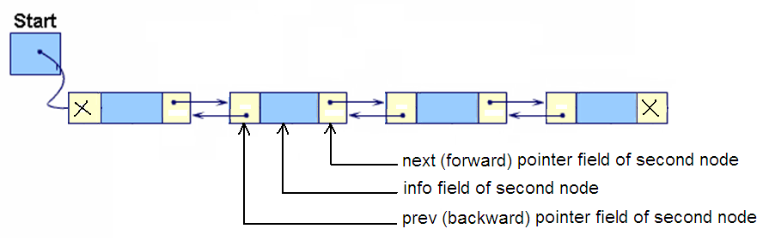
Doubly Linked List

Slide 34
Doubly Linked List
Algorithm insertDbl (start, dataIn)
Insert data into a doubly linked list
dataIn contains the data to be inserted
Return true if successful, false otherwise
Locate insertion point in list
allocate new node
move dataIn to new node
if (pPre is null)
Inserting before first node or into empty list
set new node prev pointer to null
set new node next pointer to start
set start to new node
else
Inserting into middle or end of the list
set new node next pointer to pPre next pointer
set new node prev pointer to pPre
end if
if (pPre next not null or new node next not null)
Inserting in middle of list – point successor to new
set successor prev to new node
end if
set pPre next to new node
return true
end insertDbl

Slide 35
Doubly Linked List - ADT
Struct dblNode
{
int data;
struct dblNode *prev;
struct dblNode *next;
};

Slide 36
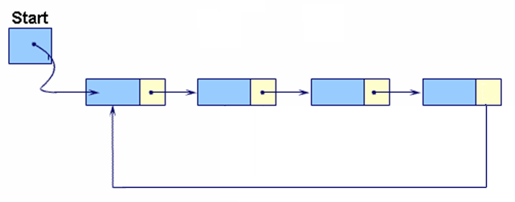
Circular Linked Lists
In Circular linked list, the last node’s link points to the first node of the list

Slide 37
From any point in the list, it is possible to reach any other point in the list
Circular linked list does not have a first and last node (Establish first and last node by convention)
Circular linked list can be used to represent a stack or a queue

Slide 38
Linked list problems
WCE - SY (CSE) – 1CI 202: Data Structures
Course Teacher: Dr. Smriti H. Bhandari

Slide 39
Program for n’th node from the end of a Linked List
39
Maintain two pointers – reference pointer and main pointer. Initialize both reference and main pointers to head. First, move the reference pointer to n nodes from head. Now move both pointers one by one until the reference pointer reaches the end. Now the main pointer will point to nth node from the end. Return the main pointer
Find the middle of a given linked list
Traverse linked list using two pointers. Move one pointer by one and the other pointers by two. When the fast pointer reaches the end slow pointer will reach the middle of the linked list
Detect loop in a linked list
Store address of any one node in a variable, then see if we find same address again

Slide 40
Program for n’th node from the end of a Linked List
40
Maintain two pointers – reference pointer and main pointer. Initialize both reference and main pointers to head. First, move the reference pointer to n nodes from head. Now move both pointers one by one until the reference pointer reaches the end. Now the main pointer will point to nth node from the end. Return the main pointer
Find the middle of a given linked list
Traverse linked list using two pointers. Move one pointer by one and the other pointers by two. When the fast pointer reaches the end slow pointer will reach the middle of the linked list
Detect loop in a linked list
Store address of any one node in a variable, then see if we find same address again

Slide 41
Stacks and Queues
[Module – 3]
WCE - SY (CSE) – 1CI 202: Data Structures
Course Teacher: Dr. Smriti H. Bhandari

Slide 42




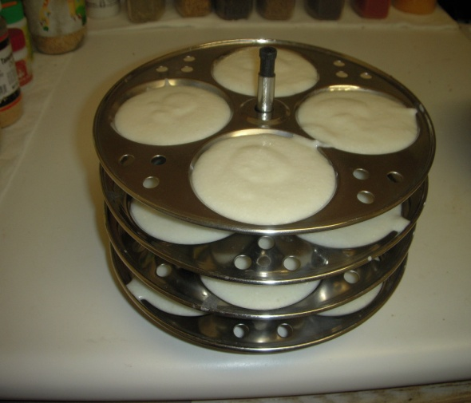
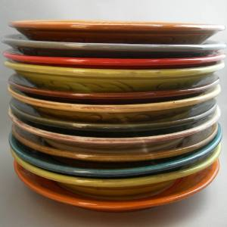
Stack - Introduction
Stack is a linear data structure
Stack is a Last-In-First-Out (LIFO) data structure in which all insertions and deletions are restricted to one end, called the top.
Notes:
The linear lists and arrays discussed in the previous modules allowed one to insert and delete elements at any place on the list at the beginning at the end or in the middle. There are certain frequent situations in computer science when one wants to restrict insertion and deleting so that they can take place only at the beginning or in the end and not in the middle one such data structure that is used for such situation is stacks.

Slide 43
Basic Stack Operations
Push
Used to insert data into the stack
Pop
Used to remove data from a stack and returns the data to calling module
Stack top
Used to return data at the top of the stack without deleting the data from the stack

Slide 44
Ways to implement stacks
Sequential Array Implementation
Linked List Implementation

Slide 45
Stack – Array Implementation
# define MAX 100
struct stack
{
int top;
int data [MAX];
};
struct stack s;

Slide 46
Stack ADT Linked list
typedef struct node
{
void* dataPtr;
struct node* link;
} STACK_NODE;

Slide 47
/* STACKADT – Linked List Implementation – stackADT.h */
# include <stdio.h>
# define TRUE 1
# define FALSE 0
typedef struct stack_node
{
void* dataPtr;
struct stack_node* link;
}STACK;
/* Function to check if stack is empty */
int emptyStack (STACK* pST)
{
if (pST==NULL)
return TRUE;
else
return FALSE;
}
/* Function to push (insert) data into stack */
int push (STACK **pST, void* dataInPtr)
{
STACK* pNew;
pNew= (STACK*) malloc (sizeof(STACK));
if (!pNew)
return FALSE;
else
{
pNew->dataPtr = dataInPtr;
pNew->link = *pST;
*pST = pNew;
return TRUE;
}
}
/* Function to pop (remove) the data from stack */
void* pop (STACK **pST)
{
STACK* pDlt;
void* dataOutPtr;
if ((*pST)!=NULL)
{
pDlt=*pST;
dataOutPtr = pDlt->dataPtr;
*pST=pDlt->link;
free(pDlt);
}
else
{ printf("\nStack Underflow");
dataOutPtr=NULL;
}
return dataOutPtr;
}
/* Function to retrieve stack top data */
void* stackTop(STACK* pST)
{
if (pST==NULL)
return NULL;
else
return (pST->dataPtr);
}

Slide 48
Stack - Applications
Convert Decimal Number to Binary Equivalent
e.g. 45_{D} = 101101_{B}

Slide 49
/* Program to convert Decimal Number to Binary Equivalent using STACK */
# include "stackADT.h"
void main()
{
unsigned int num;
int *digit;
STACK* top;
top = NULL;
printf("\nEnter an integer : ");
scanf("%d", &num);
while (num > 0)
{
digit = (int*) malloc (sizeof(int));
*digit = num % 2;
push (&top, digit);
num = num / 2;
}
while (! emptyStack(top))
{
digit = (int*) pop(&top);
printf("%1d",*digit);
}
printf("\n");
getch();
}

Slide 50
Stack - Applications
Expression Conversions
Infix to Postfix
Infix to Prefix
Postfix to Infix
Postfix to Prefix
Prefix to Infix
Prefix to Postfix

Slide 51
For conversion from infix to postfix we assume the following priorities
Operator Precedence/Priority
------------------------------------------------------------------
Exponent (^ or $) 3
Multiplication (*) or Division (/) 2
Addition (+) or Subtraction (-) 1
Parentheses ( 0

Slide 52
Analysis – Infix to Postfix
Infix Expression : A+B*C
Character Scanned | postFixExpr | Stack
A | A
+ | A | +
B | AB | +
* | AB | +*
C | ABC | +*
 | ABC* | +
 | ABC*+

Slide 53
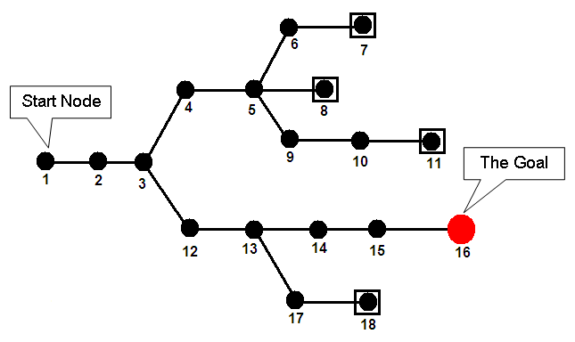
Backtracking – Goal Seeking
Notes:
Another use of stack found in applications like computer games, decision analysis and expert systems.

Slide 54
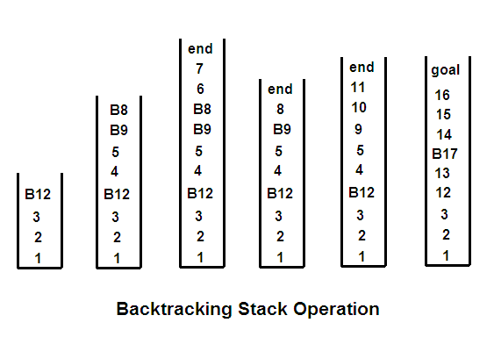
Backtracking – Goal Seeking

Slide 55

Queues
A queue is a linear list in which data can be inserted at one end, called the rear, and deleted from the other end, called front
It is a First-In-First-Out (FIFO) restricted data structure

Slide 56
Queue Implementations
Static Implementation using Array
Dynamic Implementation using Linked List

Slide 57
Queue Implementation - Static
# define MAXSIZE 100
struct queue
{
int front;
int rear;
int data[MAXSIZE];
};
struct queue q;

Slide 58
Queue Operations
Enqueue
Insert an element at the rear of the queue
Dequeue
Delete an element at the front of the queue
Queue Front
Retrieve the element at the front of the queue
Queue Rear
Retrieve the element at the rear of the queue

Slide 59
/* Sample program – QUEUE – Linked List Implementation */
# include <stdio.h>
# define TRUE 1
# define FALSE 0
/* ADT implementation */
struct queue_node
{
char data;
struct queue_node* link;
};
void queue_display (struct queue_node*);
int enqueue (struct queue_node **, struct queue_node**, char);
int dequeue (struct queue_node **, struct queue_node **, char* );
void main()
{
struct queue_node *front, *rear;
char ch;
front = rear = NULL; /* Empty Queue */
printf("\nSimple QUEUE ");
enqueue (&front, &rear, 'A');
enqueue (&front, &rear, 'B');
enqueue (&front, &rear, 'C');
queue_display(front);
dequeue(&front, &rear, &ch);
queue_display(front);
}
/* Function to display the queue contents */
void queue_display(struct queue_node *pQF)
{
printf ("\nQueue contains :\n");
while (pQF != NULL)
{
printf("%c ", pQF->data);
pQF=pQF->link;
}
}

Slide 60
/* Function to insert an element at the end of queue */
int enqueue (struct queue_node **pQF, struct queue_node **pQR , char charIn)
{
struct queue_node* pNew;
pNew= (struct queue_node*) malloc (sizeof(struct queue_node));
if (!pNew)
return FALSE;
else
{
pNew->data = charIn;
pNew->link = NULL;
if (*pQF == NULL)
*pQF = pNew;
else
(*pQR)->link = pNew;
*pQR = pNew;
return TRUE;
}
}
/* Function to remove an element from front of queue */
int dequeue (struct queue_node **pQF, struct queue_node ** pQR, char* charOut)
{
struct queue_node* pDlt;
if (*pQF == NULL)
{
printf (“\nQueue is Empty”);
return FALSE;
}
else
{
pDlt = *pQF;
*charOut = pDlt->data;
*pQF = pDlt->link;
free(pDlt);
return TRUE;
}
}

Slide 61
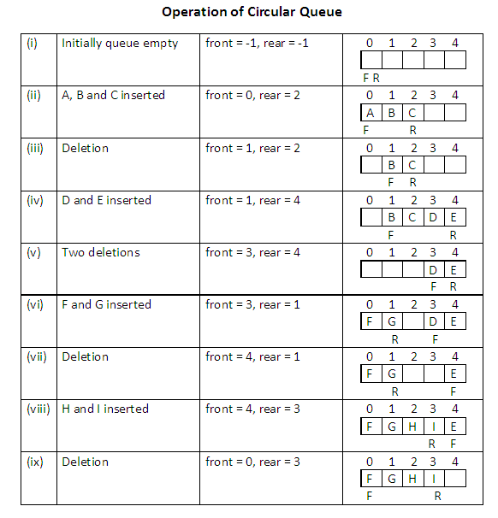
Circular Queue

Slide 62
Circular Queue
The condition to denote “circular queue full” is either one of the below:
front=0 AND rear = MAXSIZE-1
front = rear + 1

Slide 63
Priority Queue
A collection of elements such that each element has been assigned an explicit or implicit priority and such that the order in which elements are deleted and processed comes from the following rules:
An element of higher priority is processed before any element of lower priority
Two elements with the same priority are processed to the order in which they were inserted to the queue
Notes:
Both the stack and queue are data structures whose elements are ordered based on the sequence in which they have been inserted. If there is an intrinsic order among the elements themselves (e.g. numeric or alphabetic order), it is ignored in the stack or queue operations.
The priority queue is a data structure in which the intrinsic ordering of the elements does determine the results of its basic operations.

Slide 64
Priority Queue
Implicit Priority
Priority of element is decided by its value
Explicit Priority
Priority of element is decided by a priority number assigned with each element explicitly

Slide 65
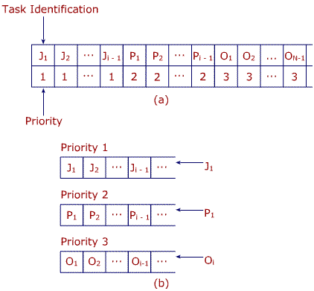
Priority Queue - Multiple
Fig(a) – Single priority queue
Fig (b) – Multiple priority queue
Separate a single priority queue into a series of queues each having its own storage structure
Now whenever elements are inserted, they are inserted in the end of one of the queues determined by their priority instead of inserting in the middle as in the case of single-priority queue, which can require the movement of several items.
➔ Efficient storage representation of a priority queue

Slide 66
Double-Ended Queue (DEQUE)
Elements can be added or removed at either end but not in the middle
Types
Input-restricted DEQUE
Allows insertions at only one end but deletions at both ends
Output-restricted DEQUE
Allows insertions at both ends but deletions at one end

Slide 67
Trees
[Module – 4]
WCE - SY (CSE) – 1CI 202: Data Structures
Course Teacher: Dr. Smriti H. Bhandari

Slide 68
Trees
Basic Terminology
Binary Trees and their representation
Binary tree traversal
Operations on binary tree
Expression Trees
General Trees
Binary Search Trees
Heaps and its operations
Introduction to Multiway Trees
Notes:
A data structure is linear if every item is related (or attached) to its previous and next item(e.g. array, linked list) and it is non-linear if every item is attached to many other items in specific ways to reflect relationships (e.g, n-ary tree). In linear data structure data items are arranged in a linear sequence. In non-linear data structure data items are not in a sequence.
Linear data structure: A linear data structure traverses the data elements sequentially, in which only one data element can directly be reached. Ex: Arrays, Linked Lists
Non-Linear data structure: Every data item is attached to several other data items in a way that is specific for reflecting relationships. The data items are not arranged in a sequential structure. Ex: Trees, Graphs

Slide 69
Basic Terminology – (7)
Root = A
Leaves = {C,D,E,G,H,I}
Parent(E) = A
Siblings(E) = {B,F}
Ancestors(C) = {B,A}
Descendents(F)={G,H,I}
Internal nodes = {B,F}
Height = 3
Level 0
A
Level 1
B
E
F
Level 2
C
D
G
H
I

Slide 70
Properties for binary trees
Height of Binary Trees
Maximum Height
If N nodes are in binary tree, then maximum height,
H_{max} = N
Minimum Height
H_{min} = ⎣log₂N ⎦+ 1
Example: If N = 3 then, H_{max} = 3 and H_{min} = 2

Slide 71
Properties for binary trees – (2)
Minimum Nodes
If H is height of the binary tree, the minimum number of nodes
N_{min} = H
Maximum Nodes
If H is height of the binary tree, the maximum number of nodes
N_{max} = 2^{H} – 1
Example: If H = 3 then, N_{min} = 3 and N_{max} = 7

Slide 72
Representing Binary Trees in Memory
Linked Representation
Using three parallel arrays
Using linked lists
Sequential Representation using single array
Notes:
The main requirement of any representation of tree T is that one should have direct access to the root R of T and, given any node N of T, one should have direct access to the children of N.

Slide 73
Representing Binary Trees in Memory
Index | Info |  | Left |  | Right
0 | K |  | -1 |  | -1
1 | C |  | 2 |  | 5
2 | G |  | -1 |  | -1
3
4 | A |  | 9 |  | 1
5 | H |  | 14 |  | 0
6 | L |  | -1 |  | -1
7
8
9 | B |  | 13 |  | 12
10
11 | F |  | -1 |  | -1
12 | E |  | 11 |  | -1
13 | D |  | -1 |  | -1
14 | J |  | 6 |  | -1
Linked representation using three parallel arrays
Root

Slide 74
Binary Tree Traversals – (2)
Two general approaches to traversal
Depth-first traversal
Breadth-first traversal

Slide 75
Binary Tree Traversals – (3)
Depth-first traversal
Processing proceeds along a path from the root through one child to the most distant descendent of that first child before processing a second child
Process all of the descendents of a child before going on to the next child

Slide 76
Binary Tree Traversals – (4)
Breadth-first traversal
Processing proceeds horizontally from the root to all of its children, then to its children’s children and so forth until all the nodes have been processed
Each level is completely processed before the next level is started

Slide 77
Depth-first Traversal
Preorder
The root of the subtree is processed first, followed by the left subtree and then the right subtree (root, left, right).
Inorder
After the complete processing of the left subtree the root is processed followed by the processing of the complete right subtree (left, root, right).
Postorder
The root is processed only after the complete processing of the left and right subtrees (left, right, root).

Slide 78
Recursive algorithm for Preorder traversal
Algorithm preOrder(root)
//Traverse a binary tree in root-left-right sequence.
if (root is not null)
process (root)
preOrder(leftSubtree)
preOrder(rightSubtree)
end if
End preOrder

Slide 79
Preorder Traversal
A
B
E
C
D
F
A
B
C
D
E
F
Processing Order in Preorder Traversal : A B C D E F

Slide 80
Recursive algorithm for Inorder traversal
Algorithm inOrder(root)
//Traverse a binary tree in left-root-right sequence.
if (root is not null)
inOrder(leftSubtree)
process (root)
inOrder(rightSubtree)
end if
End inOrder

Slide 81
Inorder Traversal
A
B
E
C
D
F
C
B
D
A
E
F
Processing Order in Inorder Traversal : C B D A E F

Slide 82
Recursive algorithm for Postorder traversal
Algorithm postOrder(root)
//Traverse a binary tree in left-right-root sequence.
if (root is not null)
postOrder(leftSubtree)
postOrder(rightSubtree)
process (root)
end if
End postOrder

Slide 83
Postorder Traversal
A
B
E
C
D
F
C
D
B
F
E
A
Processing Order in Postorder Traversal : C D B F E A

Slide 84
Breadth-first tree Traversal
Algorithm breadthFirst(root)
//Process tree using breadth-first traversal
set currentNode to root
createQueue(bfQueue)
loop (currentNode not null)
process(currentNode)
if (left subtree not null)
enqueue(bfQueue, left subtree)
end if
if (right subtree not null)
enqueue(bfQueue, right subtree)
end if
if (not emptyQueue(bfQueue))
set currentNode to dequeue(bfQueue)
else
set currentNode to null
end if
end loop
destroyQueue(bfQueue)
End breadthFirst

Slide 85
Breadth-first tree Traversal
A
B
E
C
D
F
Processing Order in Breadth-first Traversal : A B E C D F

Slide 86
General Trees
Each node can have an unlimited outdegree
Each node may have as many children as is necessary to satisfy its requirements

Slide 87
Binary Search Tree
A Binary Search Tree (BST) is a binary tree with the following properties:
All items in the left subtree are less than the root
All items in the right subtree are greater than or equal to the root
Each subtree is itself a binary search tree

Slide 88
Search BST
Compare 20 with root 23
Searching the given node in the BST
E.g. Search node 20.
Compare 20 with left subtree 18
23
18
44
12
20
35
52

Slide 89
Search BST – (2)
Algorithm searchBST (root, targetKey)
// Searches the BST for a given value
// root is the root of tree or subtree
// targetKey is the key value requested
// Returns the node address if the value is found else returns null
if (empty tree)
return null
end if
if (targetKey < root)
return searchBST (left subtree, targetKey)
else if (targetKey > root)
return searchBST (right subtree, targetKey)
else
return root // found target key
endif
End searchBST

Slide 90
Insertion into BST – (3)
Algorithm addBST (root, newNode)
// Inserts node containing new data into BST using recursion
// root is the address of current node in BST
// newNode is address of node containing data
// Returns the address of new tree root
if (empty tree)
set root to newNode
return newNode
end if
// Locate null subtree for insertion
if (newNode data < root data)
return addBST (left subtree, newNode)
else
return addBST (right subtree, newNode)
end if
End addBST

Slide 91
Deletion from BST
Delete a node from BST
To delete a node
Locate the node
Four possible cases
The node to be deleted has no children ➔ delete the node
The node to be deleted has only a right subtree ➔ delete the node and attach the right subtree to the deleted node’s parent
The node to be deleted has only a left subtree ➔ delete the node and attach the left subtree to the deleted node’s parent
The node to be deleted has two subtrees ➔ the result tends to create very unbalanced trees

Slide 92
Deletion from BST – (2)
The node to be deleted has two subtrees ➔ try to maintain the existing structure as much as possible by finding data to take the place of the deleted data
Find the largest node in the deleted node’s left subtree and move its data to replace the deleted node’s data
OR
Find the smallest node on the deleted node’s right subtree and move its data to replace the deleted node’s data

Slide 93
Deletion – (3)
Algorithm deleteBST (root, dltKey)
// Deletes a node from BST
// root is reference to the node to be deleted
// dltKey is the key of node to be deleted
// if dltKey not found, root unchanged
// Returns true if node deleted, false if not found
if (empty tree)
return false
end if
if (dltKey < root data)
return deleteBST (left subtree, dltKey)
else if (dltKey > root data)
return deleteBST (right subtree, dltKey)
else
// Delete node found – test for leaf node
If (no left subtree)
make right subtree the root
return true
else if (no right subtree)
make left subtree the root
return true
else
// Node to be deleted not a leaf. Find largest node on left subtree
save root in deleteNode
set largest to largestBST (left subtree)
move data in largest to deleteNode
return deleteBST (left subtree of deleteNode, key of largest)
end if
end if
End deleteBST

Slide 94
Program in C to implement BST and Tree Traversals
struct btreenode
{
struct btreenode *LEFT;
int INFO;
struct btreenode *RIGHT;
}

Slide 95
Heaps
Heap is a binary tree with the following properties:
The tree is complete or nearly complete
The key value of each node is greater than or equal to the key value in each of its descendents (➔max-heap)
Subtrees are also heaps
In a heap, root contains the largest (or smallest) element in the tree.
Notes:
Applications - 3) Graph Algorithms: The priority queues are especially used in Graph Algorithms like Dijkstra’s Shortest Path and Prim’s Minimum Spanning Tree.
4) Many problems can be efficiently solved using Heaps. See following for example. a) K’th Largest Element in an array. b) Sort an almost sorted array/ c) Merge K Sorted Arrays.
Operations-
extractMin(): Removes the minimum element from MinHeap. Time Complexity of this Operation is O(Logn) as this operation needs to maintain the heap property (by calling heapify()) after removing root.
Remember
Heap sort complexity is O(nlogn)
Building a heap is O(n)

Slide 96
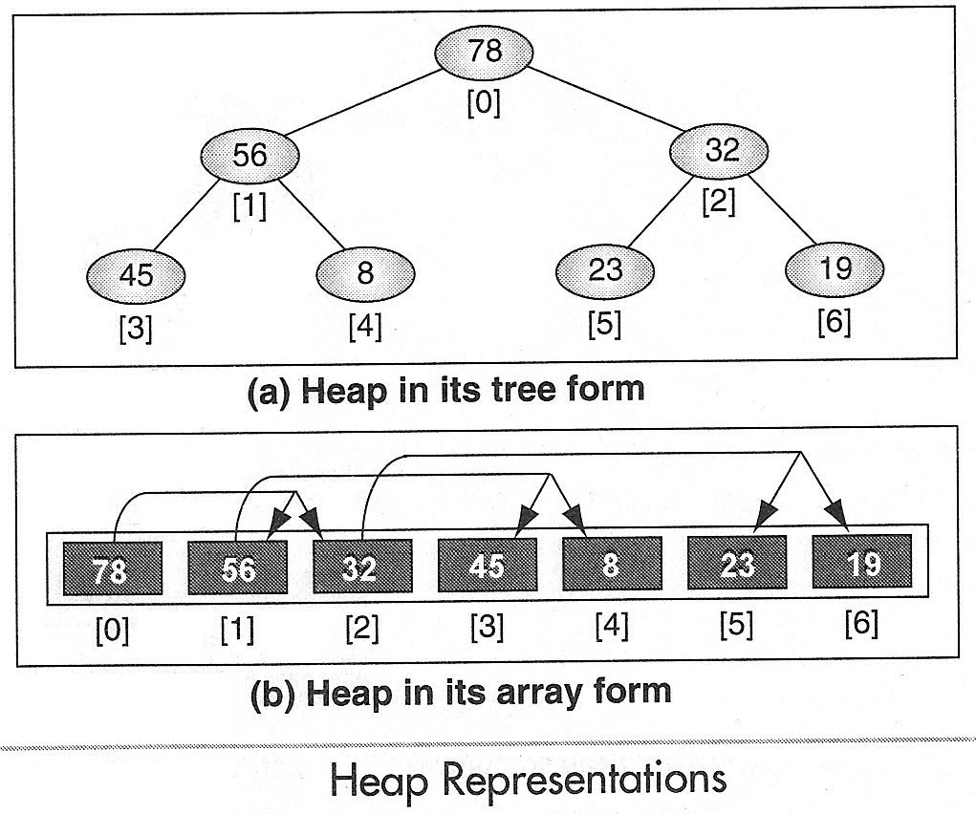
Heap
A heap can be implemented in an array because it must be a complete or nearly complete binary tree, which allows a fixed relationship between each node and its children

Slide 97
Heap Operations
Reheap Up
Reheap Down
Build a Heap
Insert data into heap
Delete Heap Node - (the root)

Slide 98
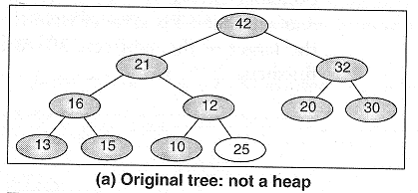
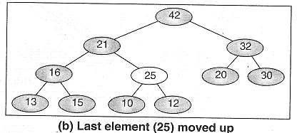
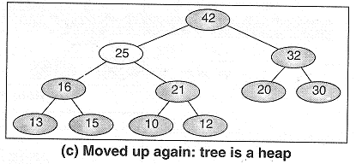
Reheap Up
Reheap up operation reorders a “broken” heap by floating the last element up the tree until it is in its correct location in the heap

Slide 99
Reheap Up
Algorithm reheapUp (heap, newnode)
// Reestablishes heap by moving data in child up to its correct location in the heap array
// heap is array containing an invalid heap
// newNode is index location to new data in heap
if (newNode not the root)
set parent to parent of newNode
if (newNode key > parent key)
exchange newNode and parent
reheapUp (heap, parent)
end if
end if
End reheapUp

Slide 100
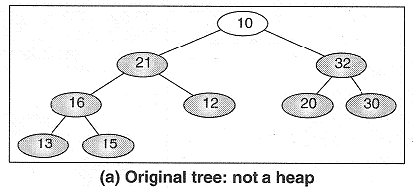
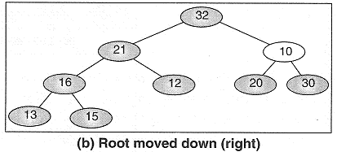
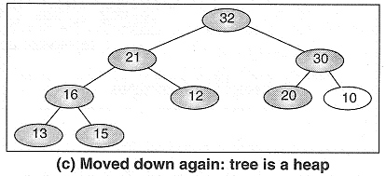
Reheap Down
Reheap down operation reorders a “broken” heap by pushing the root down the tree until it is in its correct location in the heap

Slide 101
Reheap Down
Algorithm reheapDown (heap, root, last)
// Reestablishes heap by moving data in root down to its correct location in the heap array
// heap is array of data, root is root of heap or subheap
// last is an index to the last element in heap
Determine which child has larger key
if (left subtree exists)
set leftKey to left subtree key
if (right subtree exists)
set rightKey to right subtree key
else
set rightKey to null key
end if
if (leftKey > rightKey)
set largeSubtree to left subtree
else
set largeSubtree to right subtree
end if
Test if root > larger subtree
if (root key < largeSubtree key)
exchange root and largeSubtree
reheapDown (heap, largeSubtree, last)
end if
end if
End reheapDown

Slide 102







Build Heap
Notes:
Given a filled array of elements in random order, to build the heap we need to rearrange the data so that each node in the heap is greater than its children. We begin by dividing the array into two parts, the left being a heap and the right being data to be inserted into the heap. At the beginning the root (the first node) is the only node in the heap and the rest of the array are data to be inserted.

Slide 103
Build Heap
Algorithm buildHeap (heap, size)
// Given an array, rearrange data so that they form a heap
// heap is array containing an invalid heap, size is number of elements in array
set walker to 1
loop (walker < size)
reheapUp (heap, walker)
increment walker
end loop
End buildHeap

Slide 104
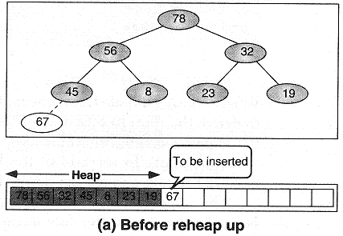
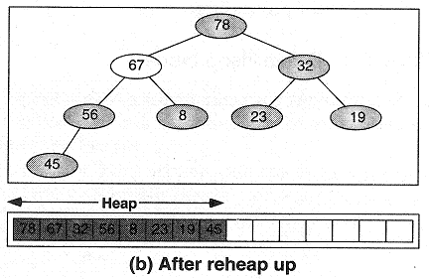
Insert node into Heap

Slide 105
Insert node into Heap
Algorithm insertHeap (heap, last, data)
// heap is an array containing a valid heap
// last is index of last (node) element in heap, data is data to be inserted
// Return true if successful, false if array full
if (heap full)
return false
end if
increment last
move data to last node
reheapUp (heap, last)
return true
End insertHeap

Slide 106
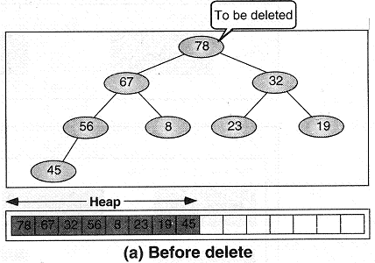
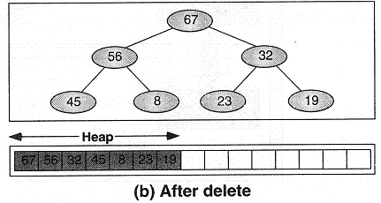
Delete Heap Node

Slide 107
Delete Heap Node
Algorithm deleteHeap (heap, last, dataOut)
// deletes root of heap and passes data back to caller
// heap is an array containing a valid heap
// last is index of last (node) element in heap, dataOut is reference for output
// Return true if successful, false if array empty
if (heap empty)
return false
end if
set dataOut to root data
move last data to root
decrement last
reheapDown (heap, 0, last)
return true
End deleteHeap

Slide 108
Exercise
Build a heap using following data:
44, 33, 11, 55, 77, 90, 40, 60, 99, 22, 88, 66
D, A, T, A, S, T, R, U, C, T, U, R, E, S

Slide 109
Multiway Trees (m-way Trees)
Properties of a nonempty multiway tree:
Each node has 0 to m subtrees
A node with k < m subtrees contains k subtrees and k – 1 data entries
The key values in the first subtree are all less than the key value in the first entry; the key values in the other subtrees are all greater than or equal to the key value in their parent entry
The keys of the data entries are ordered
key₁ ≤ key₂ ≤ … ≤ key_{k}
All subtrees are themselves multiway trees.

Slide 110
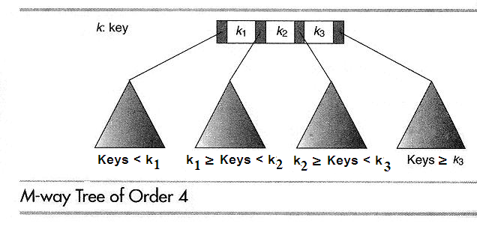
M-way Tree

Slide 111
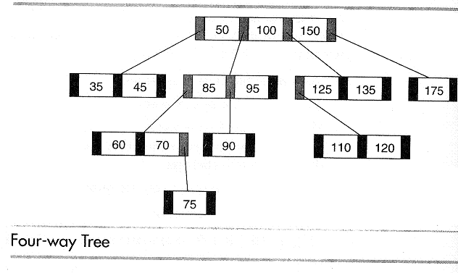
Example

Slide 112
Graphs
[Module – 5]

Slide 113
Basic Concepts
Non-linear data structure
Definition
Graph is
a collection of nodes, called vertices and
A collection of segments or lines called edges/arcs connecting pairs of vertices

Slide 114
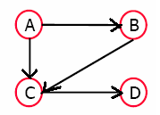
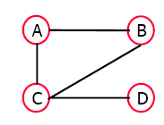
Basic Concepts (4)
Directed graph or digraph
All the edges are directed
Undirected graph
All the edges are undirected

Slide 115
Terminology – (2)
Path
A sequence of vertices v₁ ,v₂ ,. . .v_{k} such that v_{i+1} is adjacent to v_{i} for i = 1 .. k – 1
Simple path
A path with no repeated vertices (i.e. all vertices are distinct)
Cycle
A path except that the last vertex is same as the first vertex
Simple Cycle
A simple path except that the last vertex is same as the first vertex
Cyclic graph
Graph containing a cycle
Acyclic graph
Graph which does not contain a cycle

Slide 116
Terminology – (3)
Connected graph
A graph G is connected if and only if there is a simple path between any two nodes in G
Complete graph
A graph G is said to be complete if every node u in G is adjacent to every other node v in G.
Always connected
A complete graph with n nodes will have n(n-1)/2 edges.

Slide 117
Representation of Graph
Matrix Representation
List Representation
Multilist Representation

Slide 118
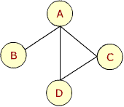
Adjacency Matrix – Example 1
A B C D
A
B
C
D

Slide 119
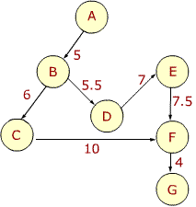
Adjacency Matrix – weighted graph
 | A | B | C | D | E | F | G
A | 0 | 5 | 0 | 0 | 0 | 0 | 0
B | 0 | 0 | 6 | 5.5 | 0 | 0 | 0
C | 0 | 0 | 0 | 0 | 0 | 10 | 0
D | 0 | 0 | 0 | 0 | 7 | 0 | 0
E | 0 | 0 | 0 | 0 | 0 | 7.5 | 0
F | 0 | 0 | 0 | 0 | 0 | 0 | 4
G | 0 | 0 | 0 | 0 | 0 | 0 | 0

Slide 120
Drawbacks of Adjacency matrix representation
Static implementation
A priori knowledge regarding number of nodes in the graph is needed
Dynamic changes in the graph are difficult to model
Wastage of space if matrix is sparse
Not possible to store additional information about the graph
Notes:
The adjacency matrix requires storage for each possible edge between each pair of nodes irrespective of the fact whether the edge exists or not. The space must be reserved for every possible edge even if the adjacency matrix is sparse.

Slide 121
Linked Representation
A linked structure that can make allocation and deallocations of nodes dynamically
Also known as adjacency structure

Slide 122
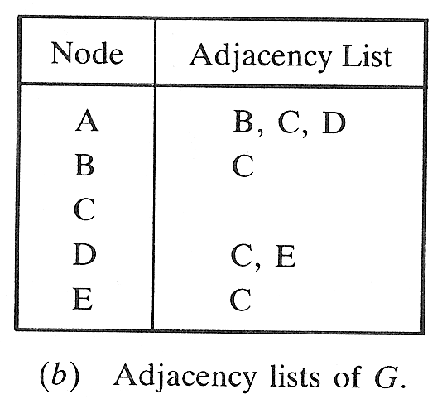
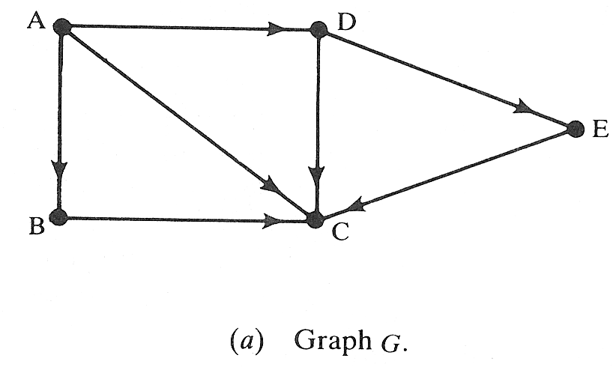
Example

Slide 123
Graph ADT
typedef struct vertex
{
struct vertex* pNextVertex;
void* dataPtr;
struct edge* pEdge;
}VERTEX;
typedef struct edge
{
struct vertex* destination;
struct edge* pNextEdge;
}EDGE;

Slide 124
Traversing a Graph
Breadth First Traversal
Uses a queue as an auxiliary structure to hold nodes / vertices for future processing
Depth First Traversal
Uses a stack as an auxiliary structure to hold nodes / vertices for future processing

Slide 125
Breadth First Traversal - Algorithm
Algorithm BreadthFirstG (graph)
Initialize all nodes to the ready state (STATUS=1)
Put the starting node N in queue (enqueue N) and change its status to the waiting state (STATUS=2)
loop(queue is not empty)
a. Remove the front node N of queue (dequeue N)
b. Process N and change the status of N to the
processed state (STATUS=3)
a. Add to the rear of queue all the neighbors of N
that are in ready state (STATUS=1)
b. Change their status to the waiting state
(STATUS=2)
end loop
end BreadthFirstG

Slide 126
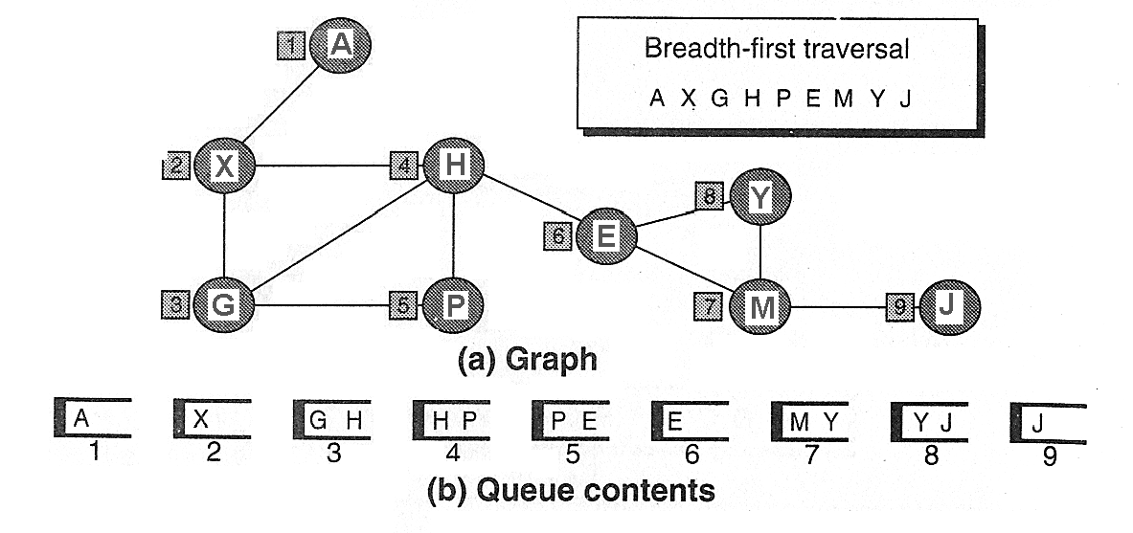
Breadth First Traversal - Example

Slide 127
Depth First Traversal - Algorithm
Algorithm DepthFirstG (graph)
Initialize all nodes to the ready state (STATUS=1)
Push the starting node N onto stack and change to the waiting state (STATUS=2)
loop (stack is not empty)
a. Pop the top node N of stack
b. Process N and change the status of N to the
processed state (STATUS=3)
a. Push onto stack all the neighbors of N that are still
in the ready state (STATUS=1)
b. Change their status to the waiting state
(STATUS=2)
end loop
end DepthFirstG

Slide 128
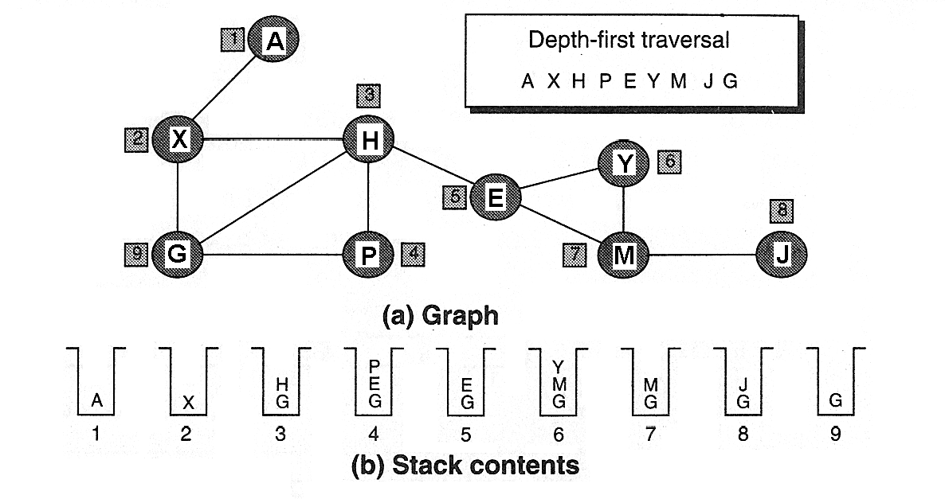
Example

Slide 129
Minimum Spanning Tree
Spanning Tree
A tree that contains all of the vertices in the graph
Minimum Spanning Tree
A spanning tree in which the total weight of the edges is guaranteed to be the minimum of all possible trees in the graph
Notes:
Applications - telephone, electrical, hydraulic, TV cable, computer
2. salesman problem. A convenient formal way of defining this problem is to find the shortest path that visits each point at least once.

Slide 130
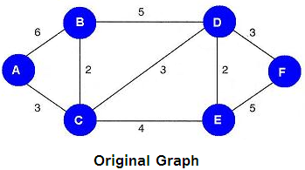
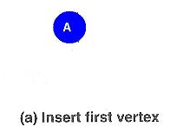
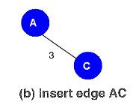
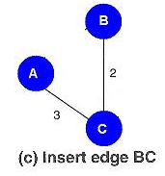
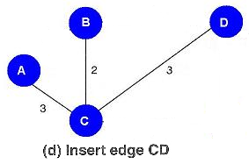
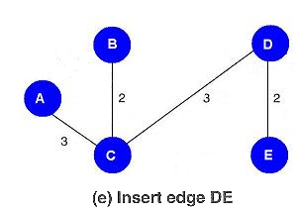
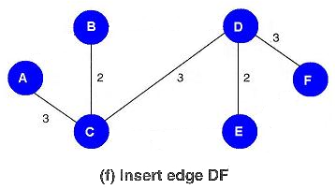
MST - Example
Notes:
Rule:
From all the vertices currently in the tree, select the edge with the minimal value to a vertex not currently in the tree and insert it into the tree.

